Slide 1

Customer Segmentation
Credit Card User
Presented By Charlie Think Tank Team JCDSVL-05
Notes:
Ini note

Slide 2






Our Team
Randy Irawani
Aditya Nugraha
Dwi Pamuji .B

Slide 3
01
Table of Contents
02
03
04
05
Problem Formulation
Describe Problem and Goals Project
Data Understanding
Explain Feature from dataset
Data Preprocessing
Make Dataset Ready for Modeling
Modeling
Train Many Model for Choice Best Model to Clustering
Conclusion and Recommendation
Trait to each Cluster and Recommendation for next project

Slide 4
01
Problem Formulation

Slide 5

Context
Marketing can help businesses increase brand awareness, one of method for the marketing team to understand their customer which is Customer Segmentation. If data about the customers is available, the data science team can help performing a customer segmentation.
Problem Formulation

Slide 6
Problem Statements and Goals
The competitive in financial industries are getting harder in the next decade. One of this industry main source of revenue are Interest Income which they could get by giving loan or credit payment facilities to customer.
We will process this data using unsupervised learning methodology to segmentize the customer by finding a certain pattern in hope we could find some characteristic between each customer segment.
Then we will analyze each segment and plan the marketing approach that work best with each segment. We also give some recommendation for the next if we want to update the model or strategies.
Problem Formulation

Slide 7
02
Data Understanding

Slide 8
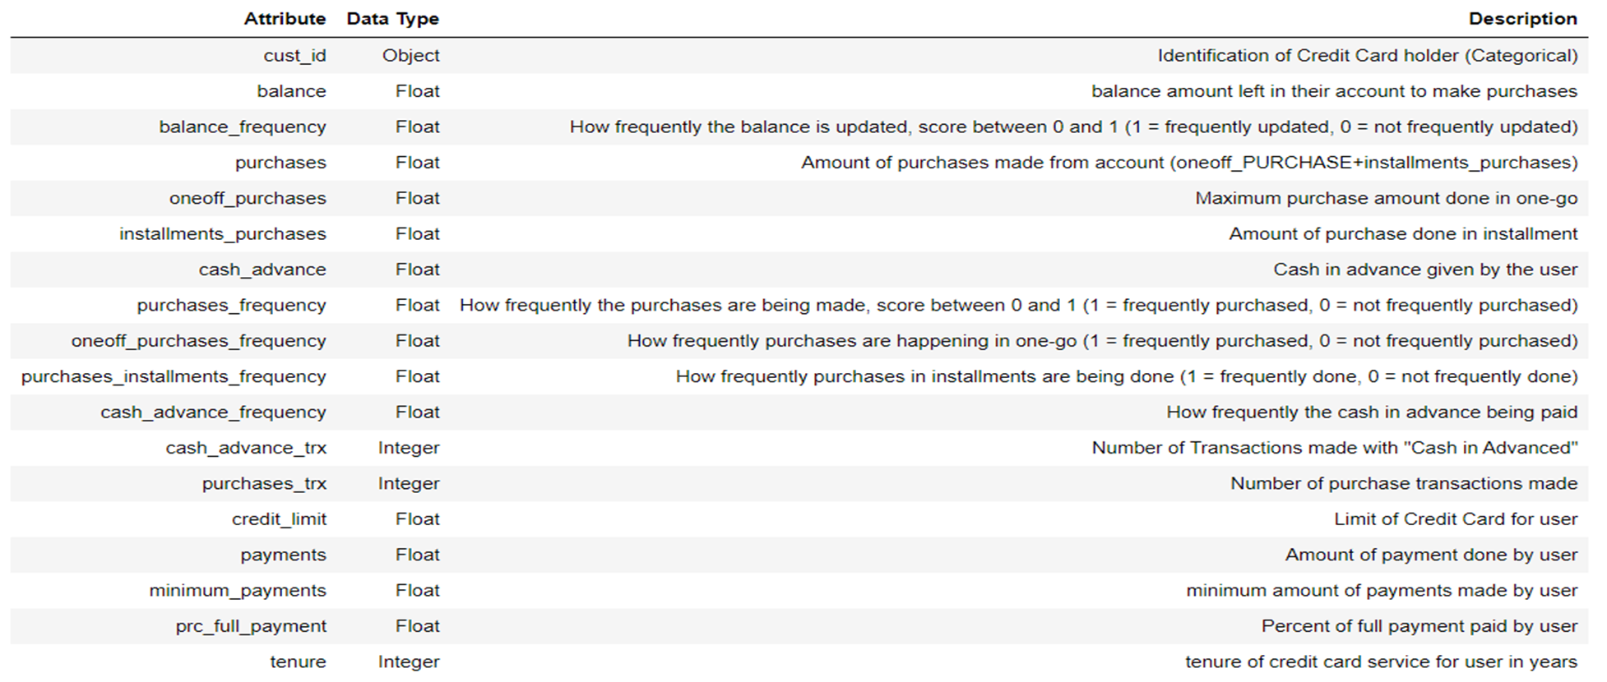
Data Dictionary
"The sample Dataset summarizes the usage behavior of about 8950 active credit card holders during the last 6 months. The file is at a customer level with 18 behavioral variables."

Slide 9
Exploratory Data Analysis

Slide 10
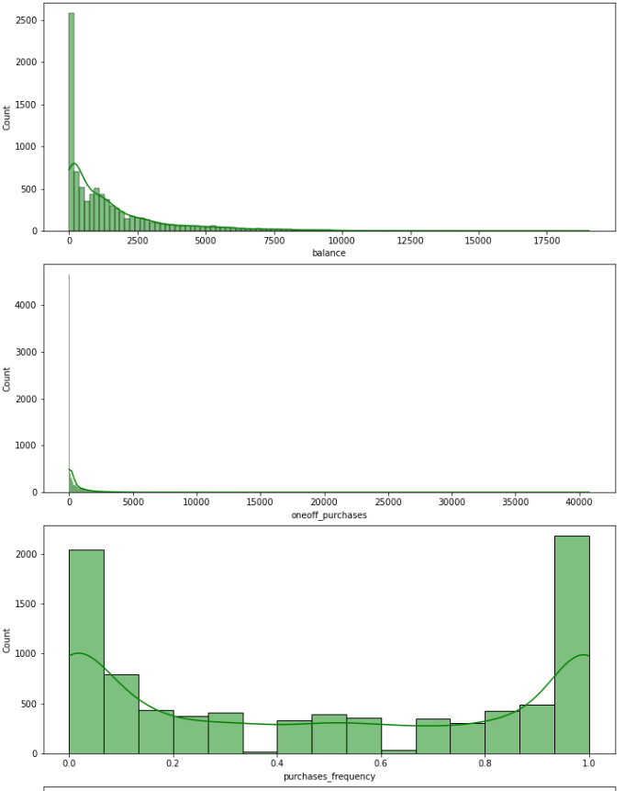
Univariate Analysis
"This Sample for Univariate Analysis"
Around 90% of users have credit limit below 13.000, have balance below 8.000 and updated frequently, paid installment below 12.000 with the minimum payment below 5.000, and the tenure are still in 12th month.
We assume that:
This represent the general population of the data
Balance updated represent active account (purchase, payment, withdraw, deposit, etc)
Divided by 2 group the one that never made any purchase and frequently made purchase, explained in clustering result
The data updated periodically
The credit card owned by new user or recently renewed
Exploratory Data Analysis

Slide 11
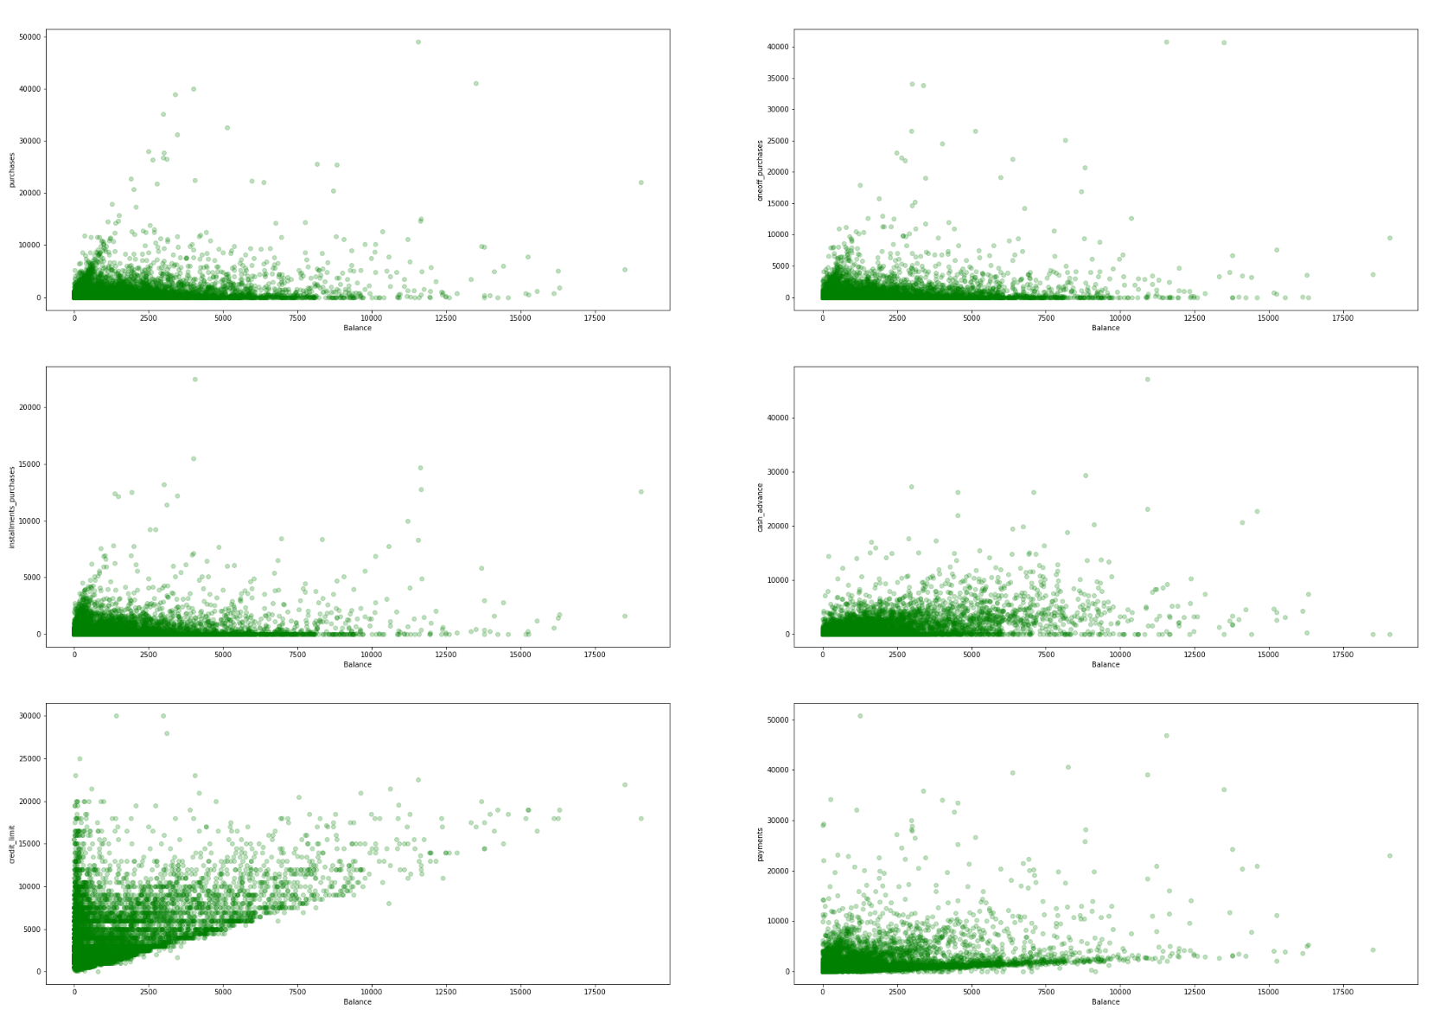
Bivariate Analysis - Balance
Key Points :
Purchases
One Off Purchases
99% of user have balance below 10.000 and most of them(more than around 80%):
Most of them already had a good spending habit and paid using one off purchase
Made total purchases up to 10.000
Made oneoff purchase up to 5.000
Made installment purchases up to 5.000
Use cash in advance up to 10.000
Have credit_limit up to 15.000
Made payment up to 10.000
Installment Purchases
Cash Advance
Credit Limit
Payment
Exploratory Data Analysis

Slide 12
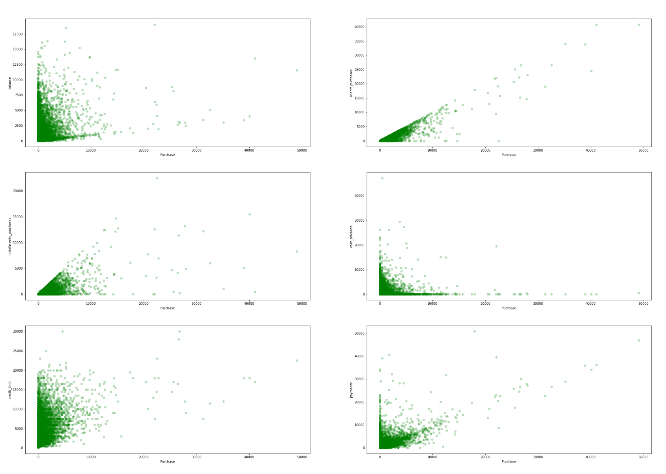
Bivariate Analysis - Purchases
Key Points :
Balance
One Off Purchases
As observed, 99% customers make purchases up to 10,000
Customer rarely paid using installment
Have a balance up to 10.000
Made one off purchases up to 10.000
Made installment purchases up to 5.000
Have credit limit up to 20.000
Made payments up to 20.000
Use cash in advance up to 10.000
Installment Purchases
Cash Advance
Credit Limit
Payment
Exploratory Data Analysis

Slide 13
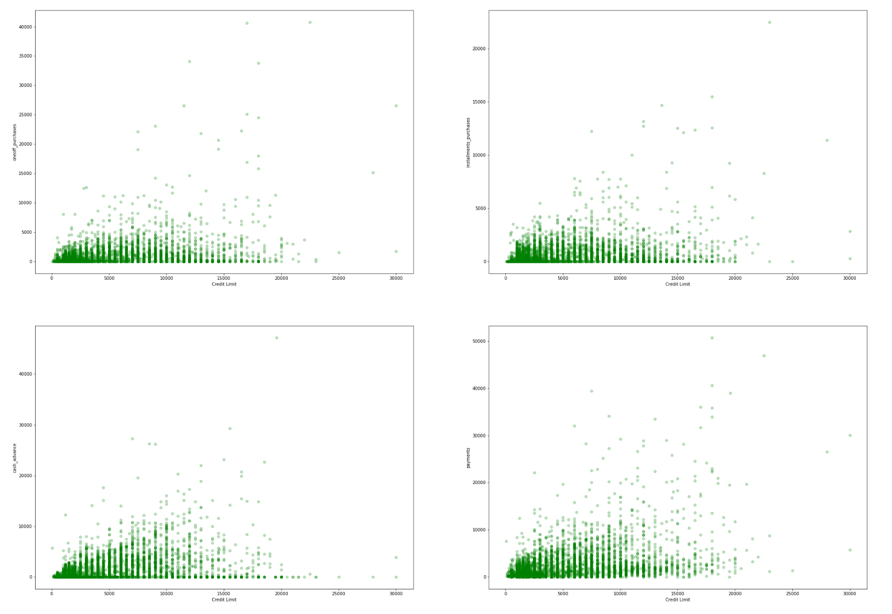
Bivariate Analysis - Credit Limit
Key Points :
99% customers have credit limit up to 20,000 and:
No issue in the credit limit given to the customer
Made one off purchases up to 5.000
Made installments purchases up to 5.000
Made payments up to 10.000
Use cash in advance up to 10.000
One Off Purchases
Installment Purchases
Cash Advance
Payment
Exploratory Data Analysis

Slide 14
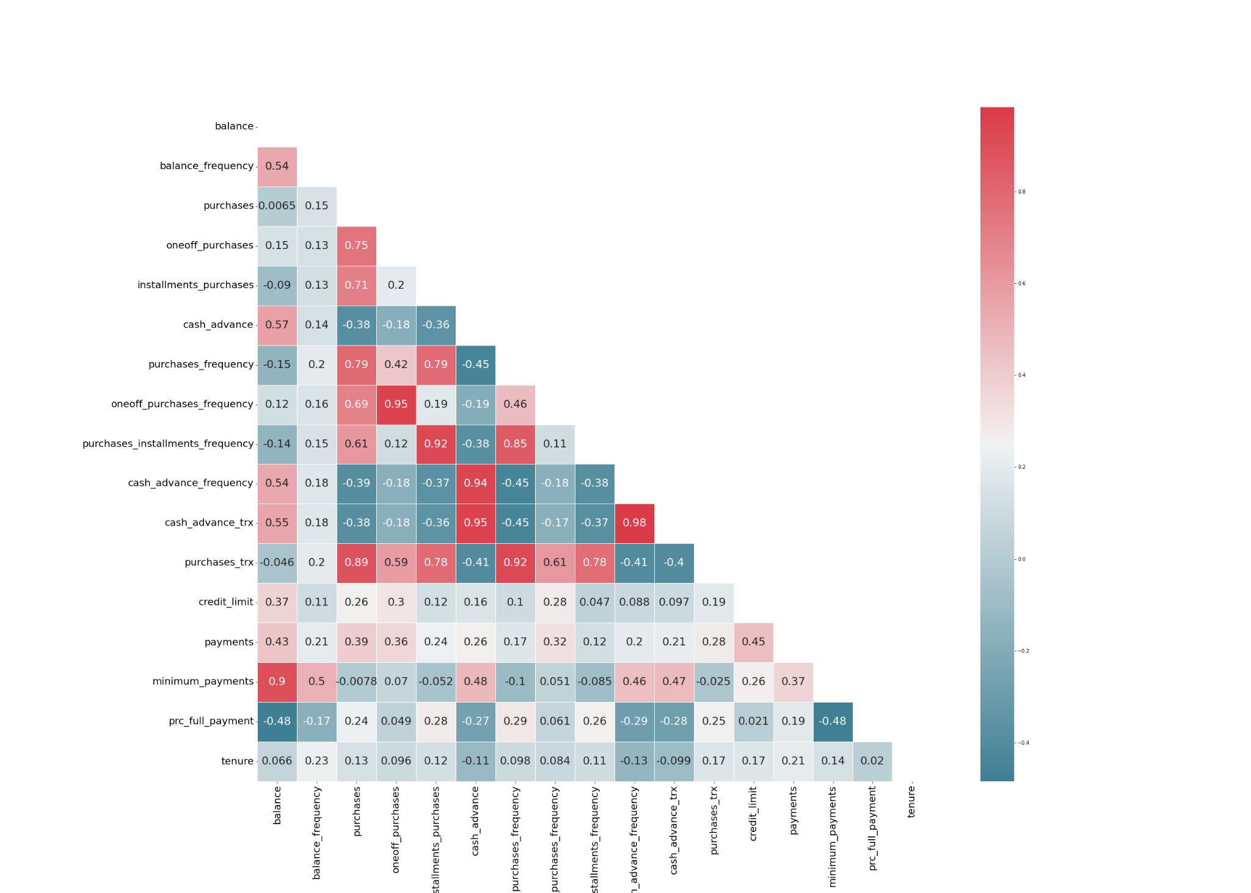
Multivariate Analysis - Correlation
Between Numerical Features
Exploratory Data Analysis

Slide 15
Multivariate Analysis - Correlation
Between Numerical Features
Very strong correlations :
One off purchases with purchases. This due to one off purchase are part of the purchase.
purchases installments frequency with purchases frequency. We assume this could indicate payments using installment method happens frequently.
Cash in advance transactions with Cash in advance frequency. We assume this could indicate that advance payments happens frequently.
Purchases with purchases transactions. We assume this indicate total purchase consist of many purchase transaction.
Medium correlations :
Installment purchase with purchases. This due to one off purchase are part of the purchase.
balance with Cash in advance. This due to balance are updated when advance payment occur.
balance with Cash in advance frequency. We assume this due to every advance payment, the balance are also updated.
balance with Credit limit. We assume this due to balance are one of major point bank decide credit limit given to the customer.
Exploratory Data Analysis

Slide 16
03
Data Preprocessing

Slide 17
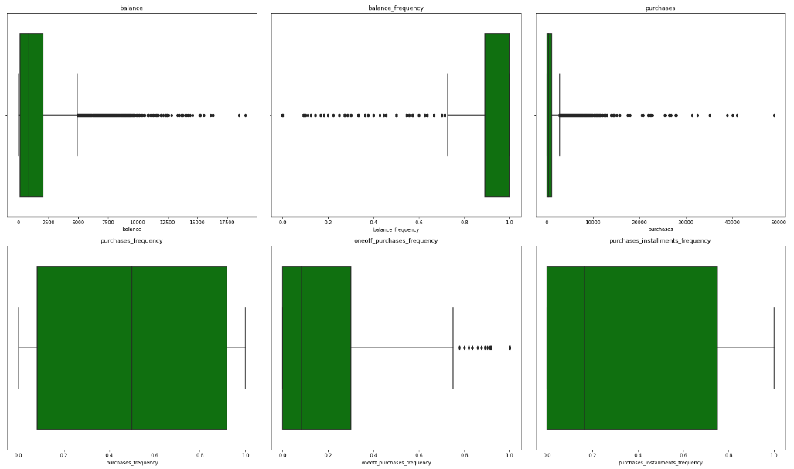
Check Outlier
For check outlier we used Q1 and Q3 for determine outlier , less than Q1 and more than Q3 as outlier . result we find 5238 (58.52%) outlier, We assume this occurs because social inequality
"This Sample for Boxplot Outlier"
Data Preprocessing

Slide 18
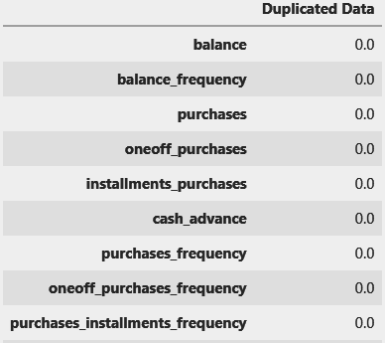
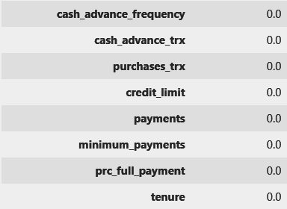
Check Duplicated Data
We not Find duplicate data in dataset
Data Preprocessing

Slide 19
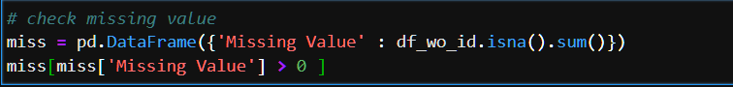
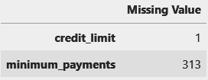
Check Missing Value
We use isna and sum function for check missing value
We find 314 Missing Value
Data Preprocessing

Slide 20
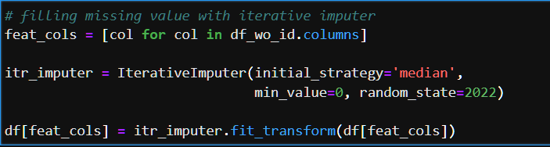
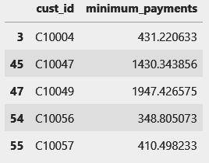
Handling Missing Value
For handling missing value we used iterative imputer with initial strategy : “median”
Example Result Iterative Imputer :
Data Preprocessing

Slide 21
Drop Feature
"Since our goal in this project was customer segmentation based on customer behavior, we only used features related to our goals and removed other features"
Not related:
cust_id
credit_limit
minimum_payments
tenure
Represented by other features:
purchases (explained by installment_purchase and oneoff_purchase)
Balance (represented by balance_frequency)
cash_advance (represented by cash_advance_frequency)
cash_advance_trx (represented by cash_advance_frequency)
purhcase_trx (represented by purchases_frequency)
payments (represented by payments_proportion)
Data Preprocessing
Notes:
"Since our purpose in this project is clustering (customer segmentation) and only process the clustering using a customer behaviour related feature, we decided to drop several feature"
cust_id : we assume this feature only serve as indexing.
balance : we assume this feature does not portrait customer behaviour.
purchases : we assume this feature are already explained by installment_purchase and oneoff_purchase.
cash_advance : we assume this feature shows the amount of cash advance. this feature represented by cash_advance_frequency.
cash_advance_trx : we assume this feature shows the number of cash advance made. this feature represented by cash_advance_frequency.
purchase_trx : we assume this feature shows the number of purchase made. this feature represented by purchase frequency.
credit_limit : we assume this feature does not portrait customer behaviour.
payments : we assume this feature shows the amount of payments made and already represented by payments proportion.
minimum_payments : we assume this feature does not portrait customer behaviour.
tenure : we assume this feature does not portrait customer behaviour.

Slide 22
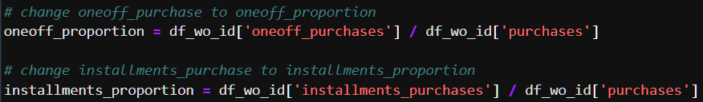
New Feature
We make 2 new feature :
One off Proportion, result feature one off purchases divided by purchases
Installment Proportion, result feature Installment purchases divided by purchases
"We make this feature to find out the proportion of customer purchases"
Data Preprocessing

Slide 23
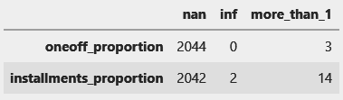
Check New Feature
We noted that there are 2.041 missing value and 3 value that are bigger than 1 in oneoff_proportion and 2.039 missing value, 2 infinite number, and 14 value that are bigger than 1.
Since this is unusual value, we decided to transform it to reasonable value.
The missing value is due to zero value in oneoff_purchase/installment_purchase divided by zero value in purchases. We will fill the missing value with zero value.
For the infinite number is due to value in installment_purchase divided by zero value in purchase. We decided to change the number to 1, we assume that all purchase is made by installment.
For all the value that is bigger than 1, we decided to change the number to 1. Since the feature nature is proportion, and the max value is 1.
Data Preprocessing

Slide 24
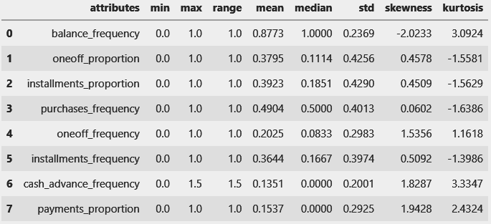
Summary Feature for Modeling
"Finally we get dataframe for modeling which contains 8 features related to customer behavior, Next we will do PCA on this dataframe"
Data Preprocessing

Slide 25
04
Modeling

Slide 26
Modeling
Workflow

Slide 27
Modeling Workflow
Data Model
Modeling
Analysis
Data after proses cleaning and preprocessing
Training 3 model with many cluster and metric
Analyze each cluster
PCA
Best Model
Reduce the number of feature
Compare 3 Model for Clustering with metric to get best model and cluster

Slide 28
Principal Component Analysis

Slide 29
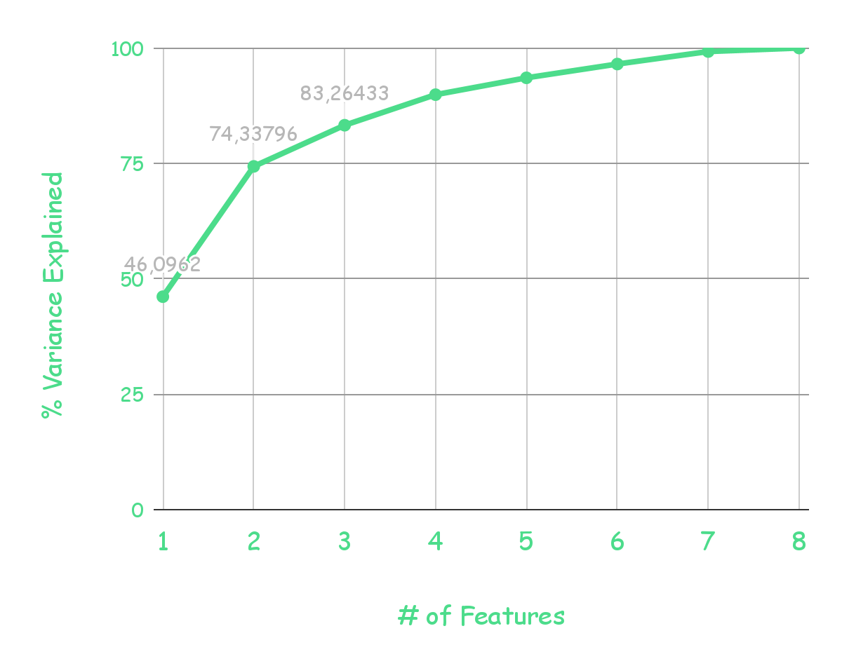
Cumulative Proportion of Variance
Variance
Explained
Shows what percentage of information is extracted based on how many components are present.
Based on the graph we use 2 components for the next stage.
Modeling

Slide 30
Model for Clustering

Slide 31
Model for Clustering
Agglomerative
K-Means
K-Medoids
Clustering strategic in hierarchy clustering starting with each object in a separate cluster and then forming an increasing large clustering.
Partitioning clustering method to separates data into dIfferent clusters. by iterative partitioning, its clustering is able to minimize the average of distance of each data to its cluster
Variant of the K-Means method. It is based on the use of a medoid instead of observations held by each cluster, with the aim of reducing the sensitivity of the resulting partition with respect to the extreme values present in the dataset
Modeling

Slide 32
Agglomerative Clustering
Metric Scores

Slide 33
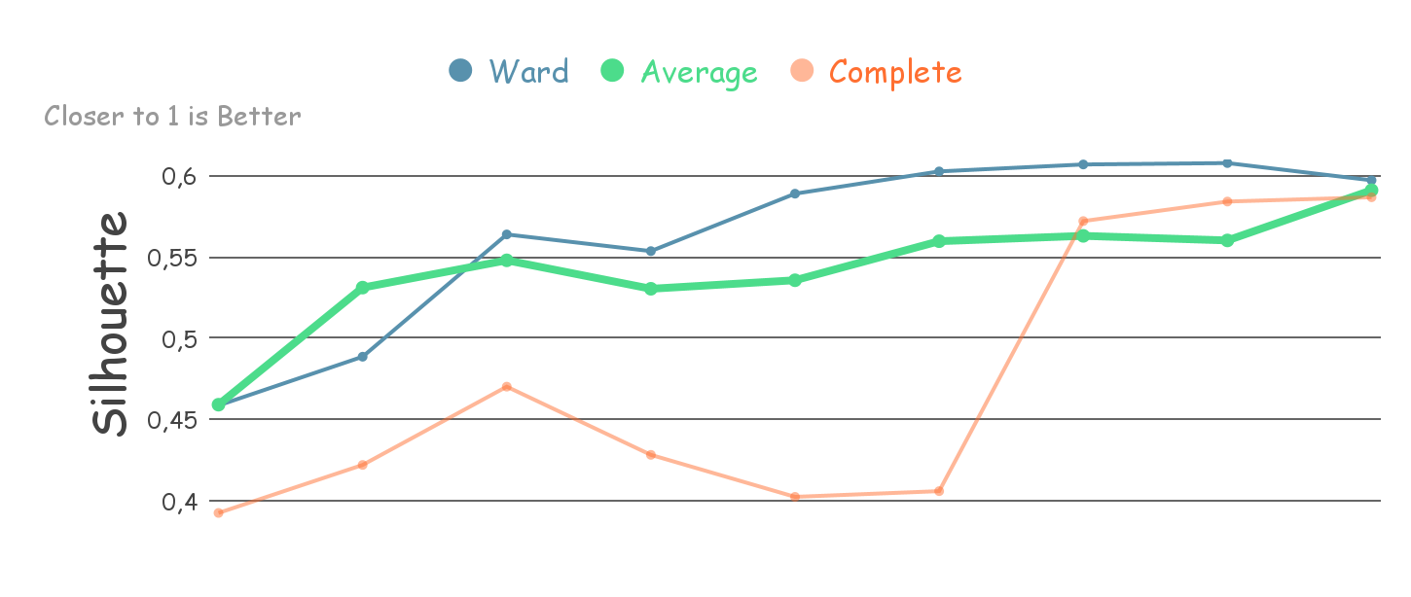
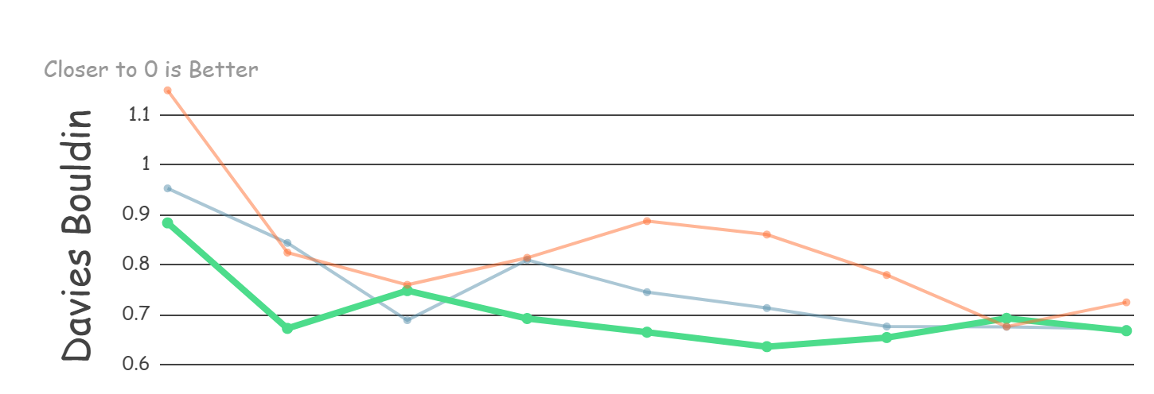
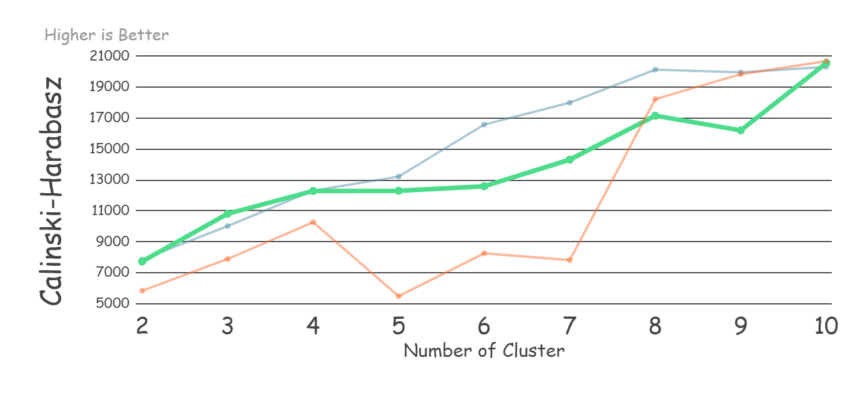
Our Preferred Metric & Clusters
For further comparison we use Average with 4 clusters for the following reasons:
Silhouette score and Calinski-Harabasz score are the points before the score decrease
Davies-Bouldin score although quite bad but not the worst
Agglomerative Metric Scores

Slide 34
K-Means
Metric Scores

Slide 35
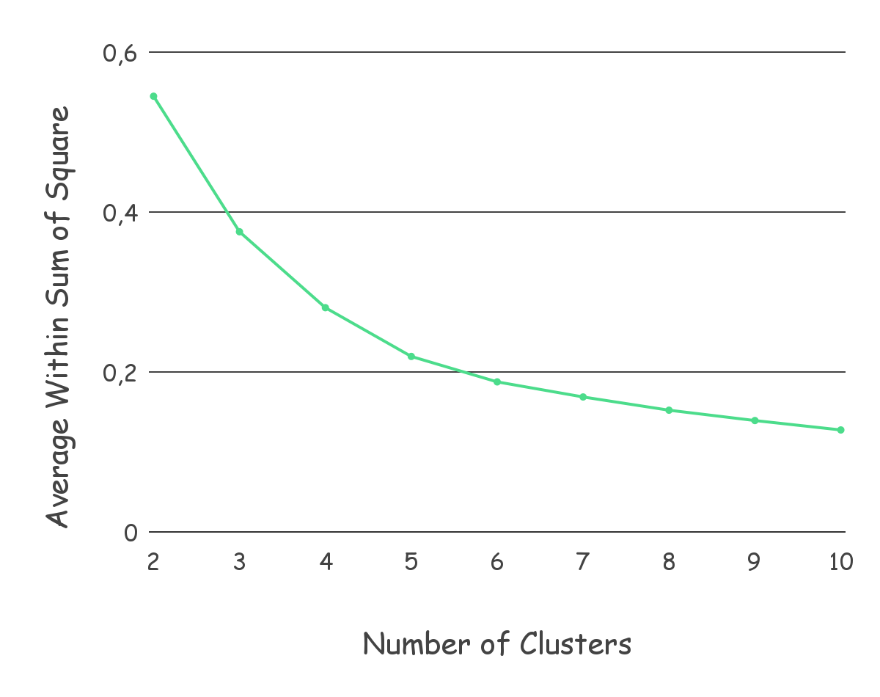
Elbow Method
Within-Cluster Sum of Square
A measure of the variability of the observations within each cluster
We will take the value that changes the most significantly, which is 4 or 5 clusters
K-Means Metric Scores

Slide 36
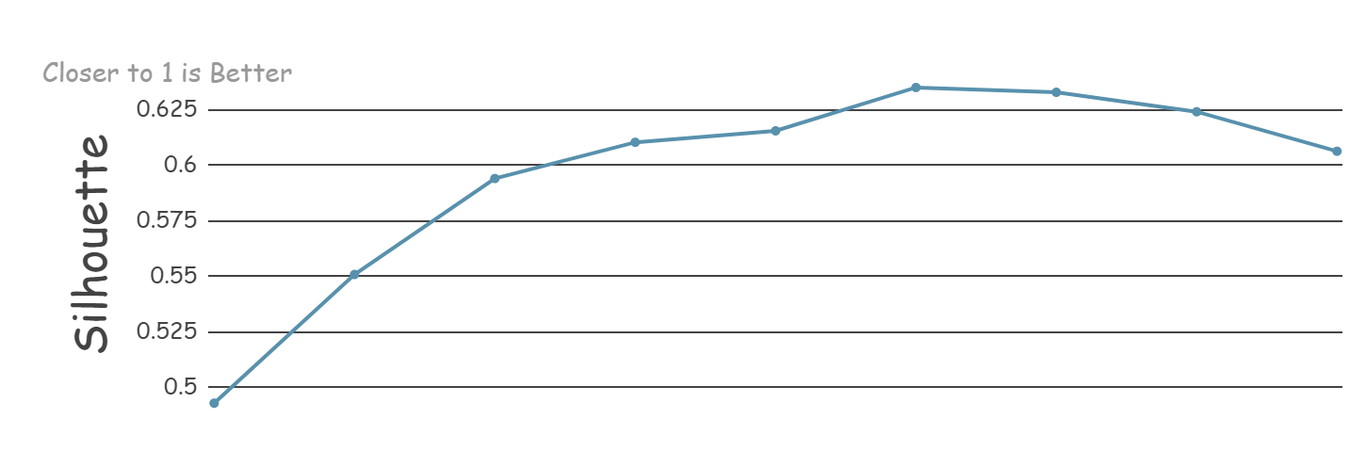
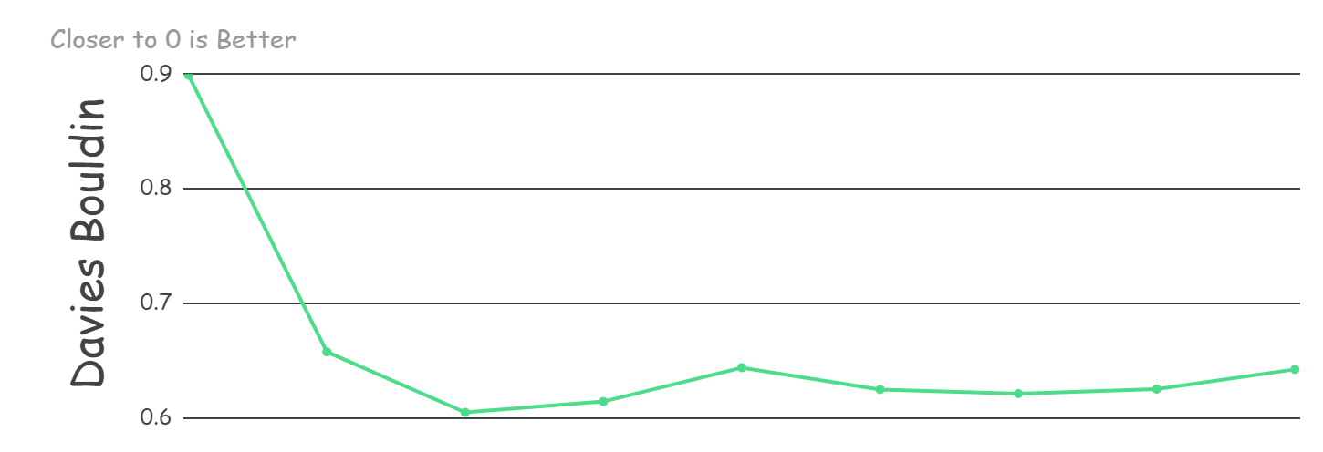
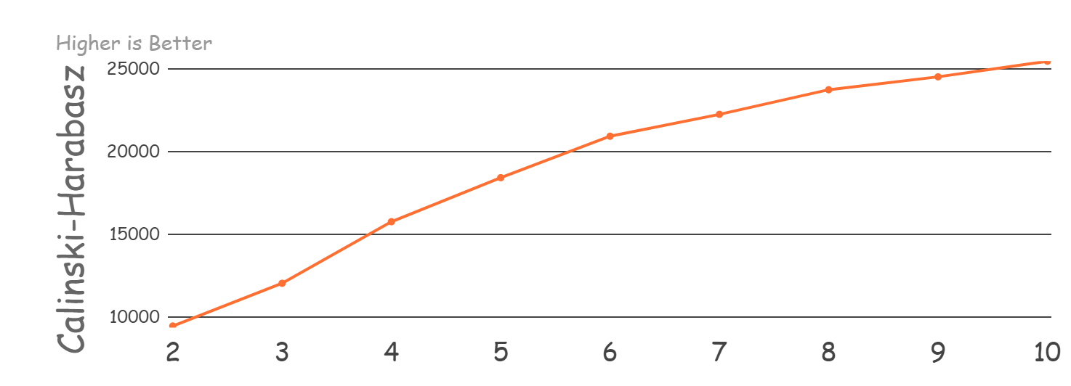
Our Preferred Metric & Clusters
For further comparison we use 4 clusters for the following reasons:
Silhouette score and Calinski-Harabasz score are considered sufficient because they have a large change in value compared to others
Davies-Bouldin score is the best (lowest)
In the previous WSS chart, the value of 4 or 5 clusters was selected.
K-Means Metric Scores

Slide 37
K-Medoids
Metric Scores

Slide 38
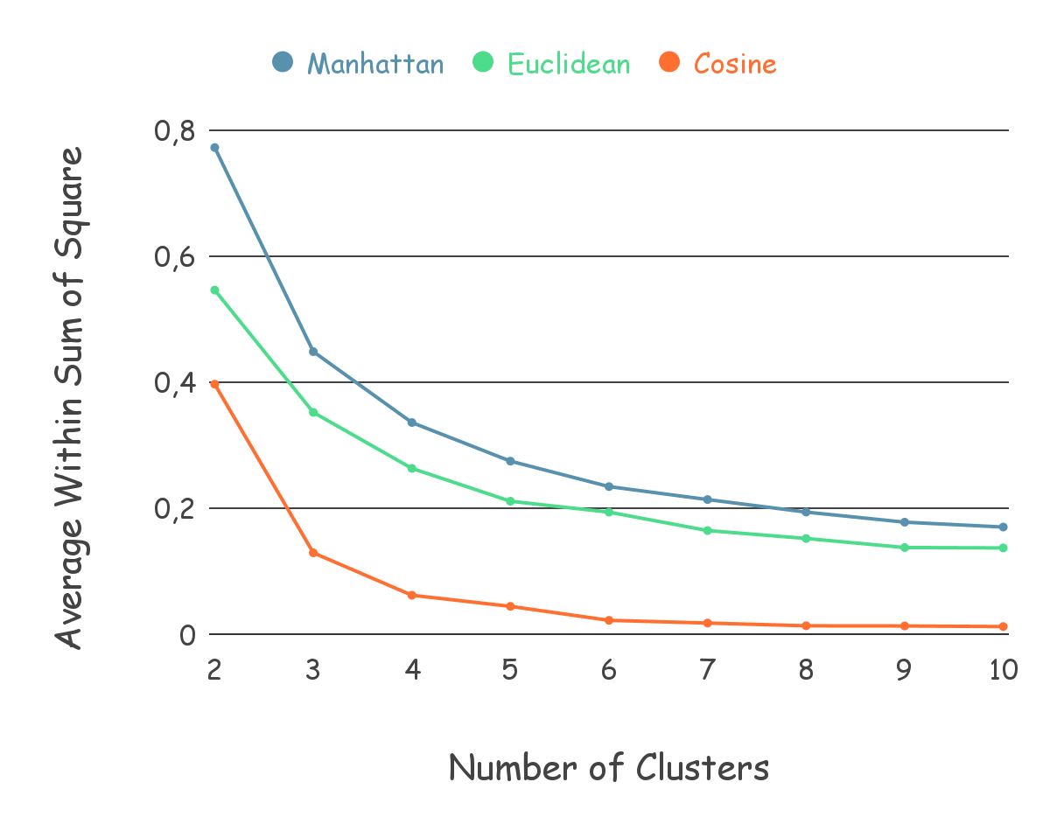
Elbow Method
Within-Cluster Sum of Square
A measure of the variability of the observations within each cluster
We will take the value that changes the most significantly, which is 3 or 4 clusters
K-Medoids Metric Scores

Slide 39
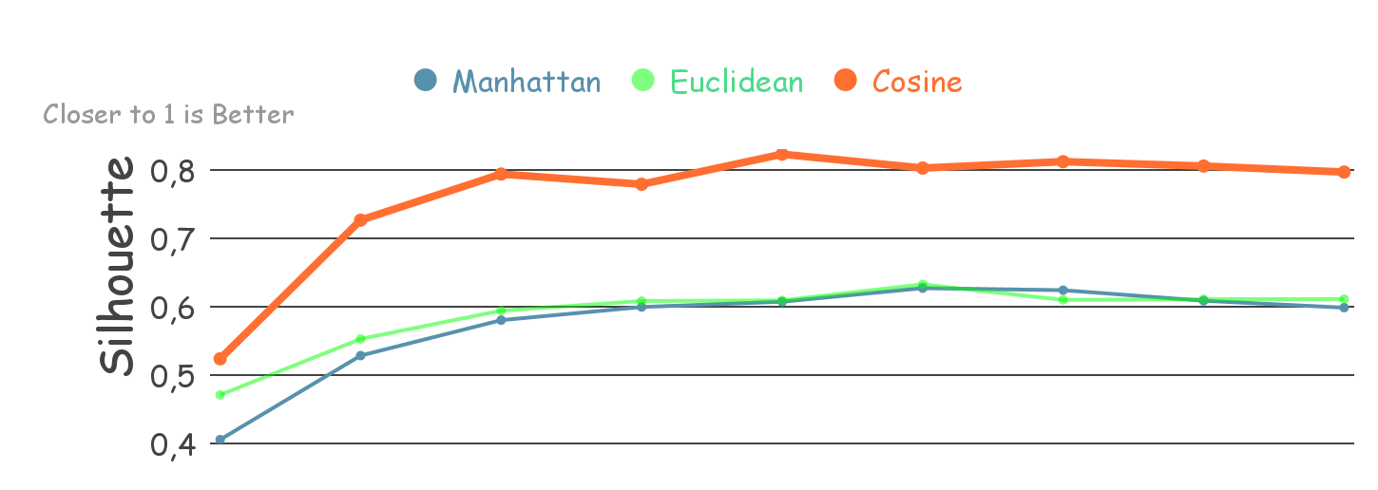
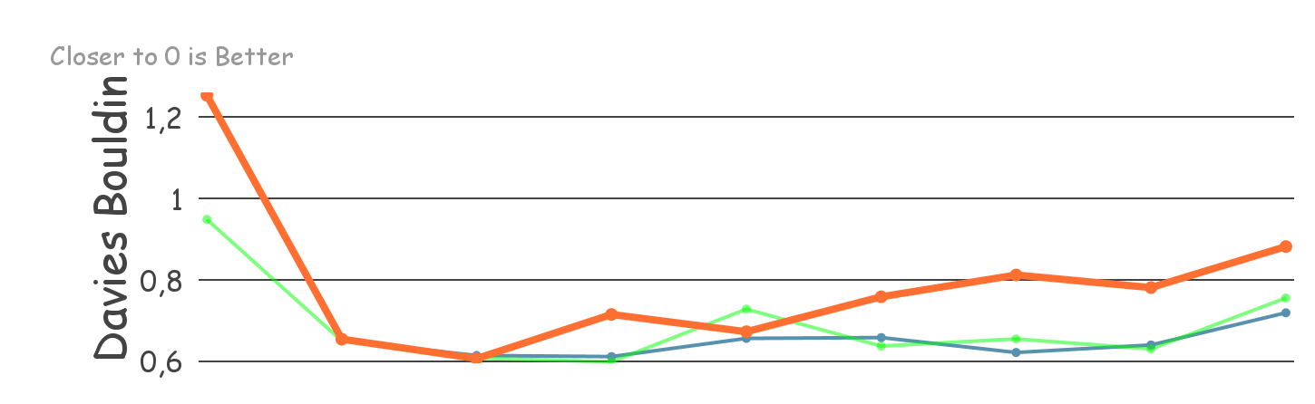
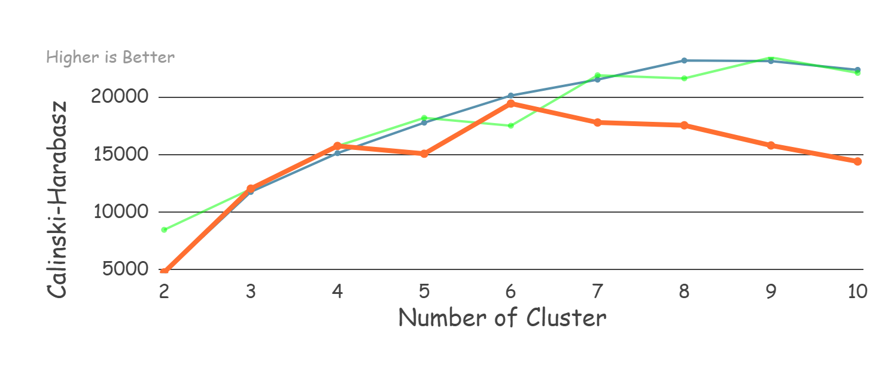
Our Preferred Metric & Clusters
For further comparison we use Cosine with 4 clusters for the following reasons:
Silhouette score and Davies-Bouldin score are the best scores compared to other scores
Calinski-Harabasz score is the points before the score decrease
In the previous WSS chart, the value of 3 or 4 clusters was selected.
K-Medoids Metric Scores

Slide 40
Model
Comparison
for Final Model

Slide 41
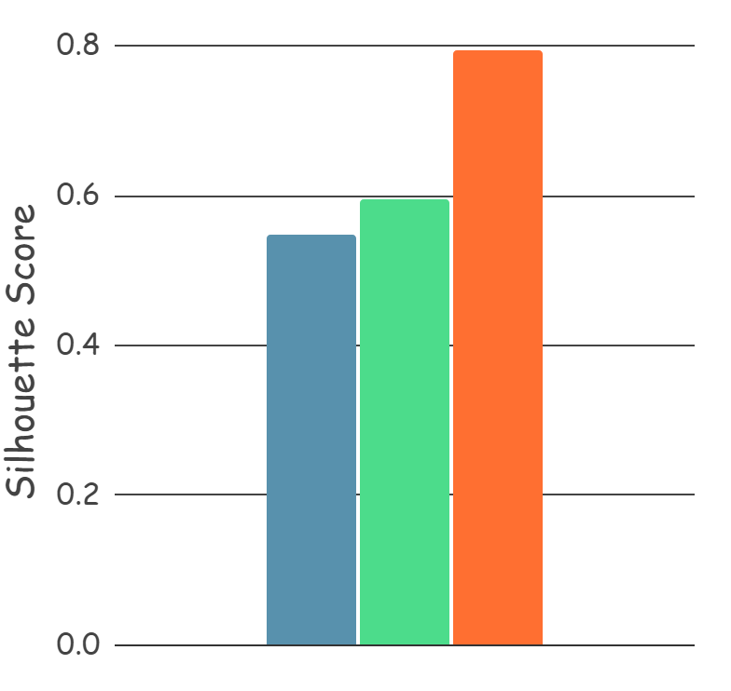
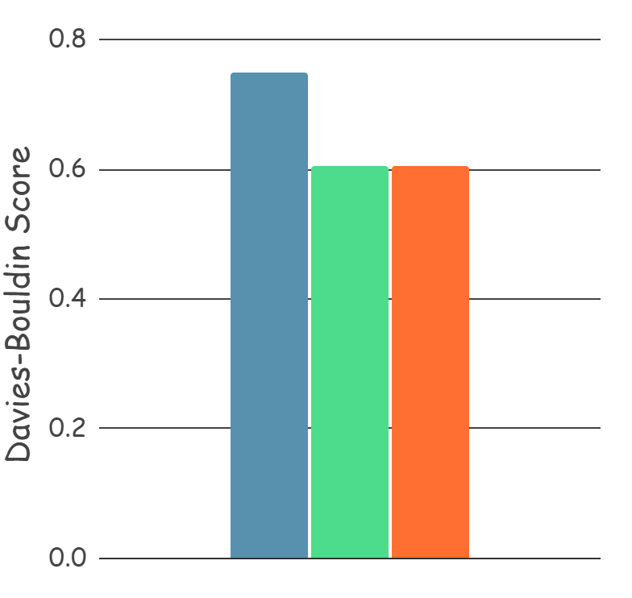
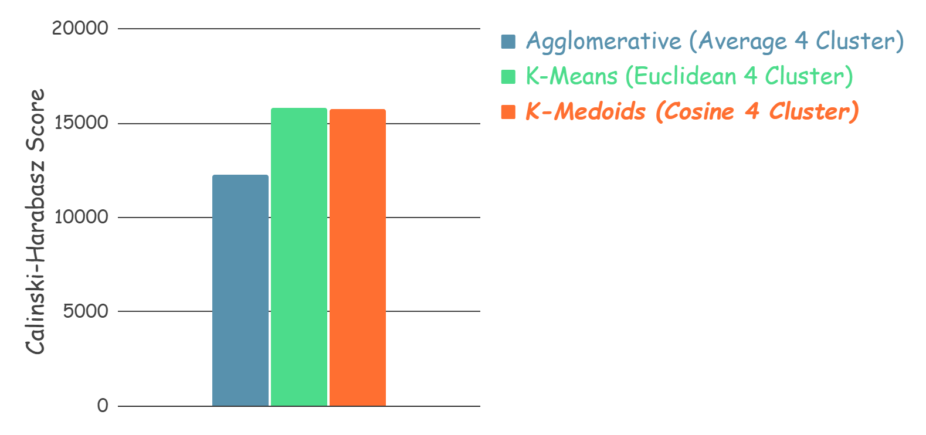
Our Preferred Model
For final model we use K-Medoids Cosine with 4 Clusters for the following reasons :
Silhouette score is much higher than others
Davies-Bouldin score is similar to k-means, which has the best score (lowest)
Calinski-Harabasz score is similar to k-means, which has the best score (highest)
Model Comparison for Final Model

Slide 42
K-Medoids Explanation

Slide 43
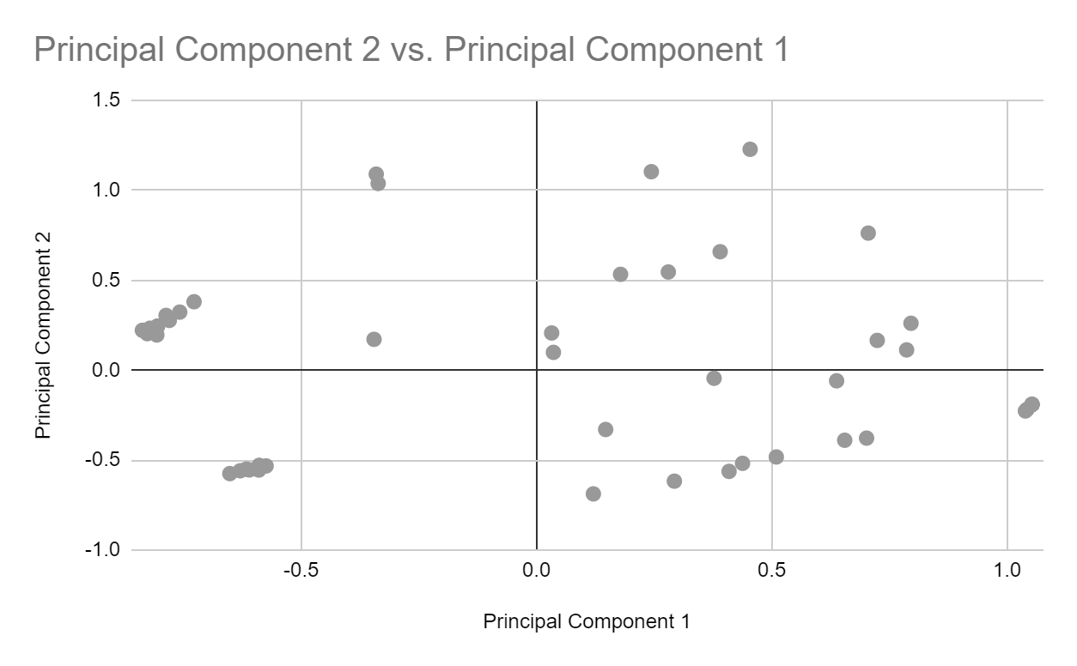
How K-Medoids Work
"This Sample take from 50 first data in dataset"
Step 1 : Choose Number of K
K = 4
Step 2 : Initialize K Medoids randomly
Step 3 : Assign each point to the closest medoids
Step 4 : Recalculate medoids
Step 5 : Iterative (Step 3 - 4)
K-Medoids Explanation

Slide 44
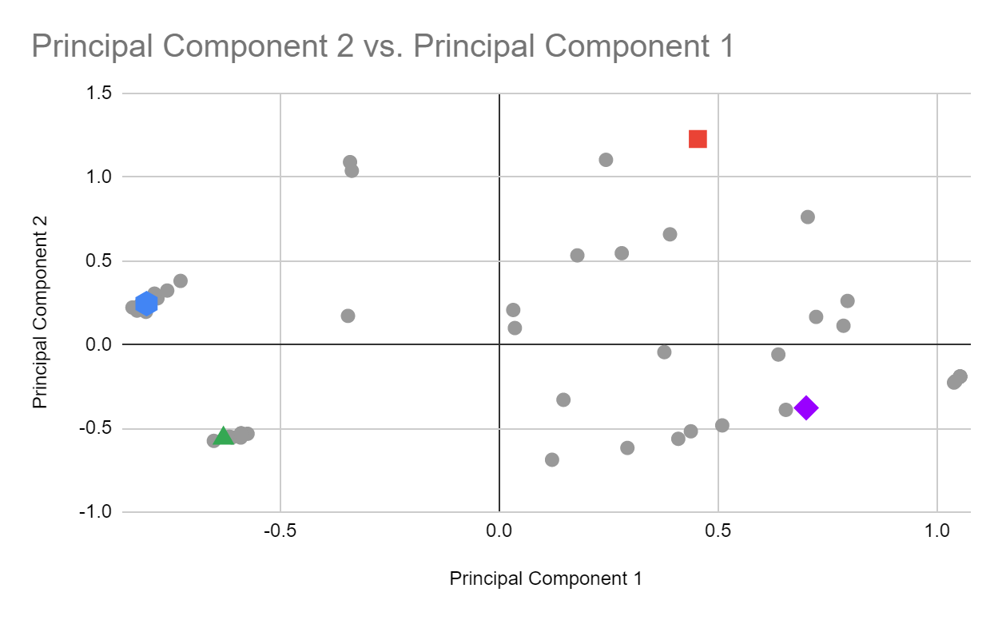
How K-Medoids Work
"This Sample take from 50 first data in dataset"
Step 1 : Choose Number of K
K = 4
Step 2 : Initialize K Medoids randomly
Step 3 : Assign each point to the closest medoids
Step 4 : Recalculate medoids
Step 5 : Iterative (Step 3 - 4)
K-Medoids Explanation

Slide 45
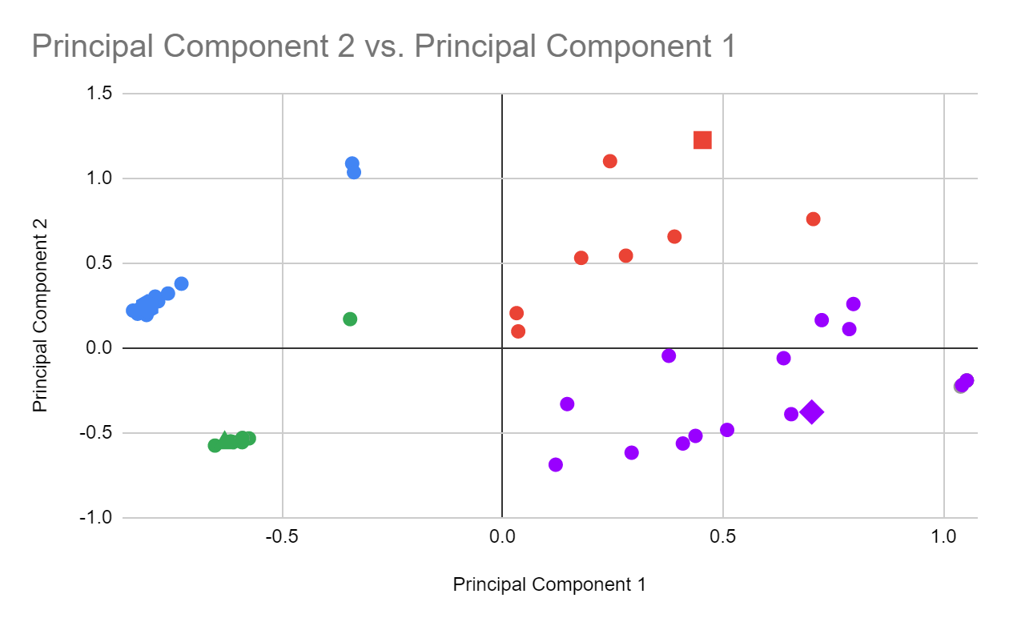
How K-Medoids Work
"This Sample take from 50 first data in dataset"
Step 1 : Choose Number of K
K = 4
Step 2 : Initialize K Medoids randomly
Step 3 : Assign each point to the closest medoids
Step 4 : Recalculate medoids
Step 5 : Iterative (Step 3 - 4)
K-Medoids Explanation

Slide 46
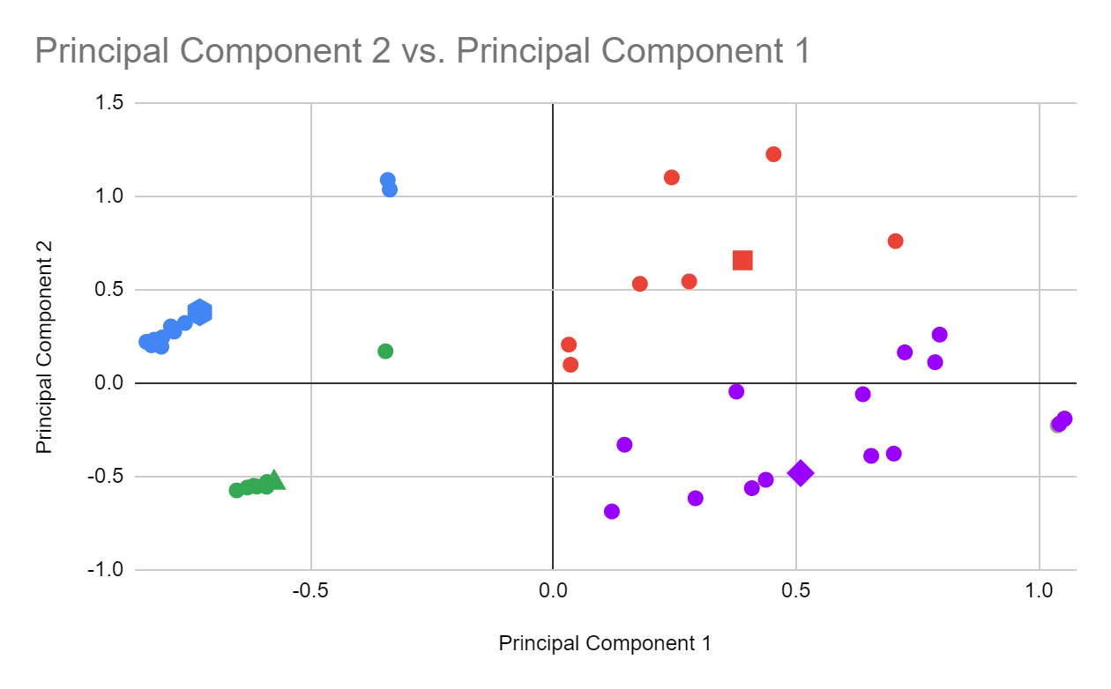
How K-Medoids Work
"This Sample take from 50 first data in dataset"
Step 1 : Choose Number of K
K = 4
Step 2 : Initialize K Medoids randomly
Step 3 : Assign each point to the closest medoids
Step 4 : Recalculate medoids
Step 5 : Iterative (Step 3 - 4)
K-Medoids Explanation

Slide 47
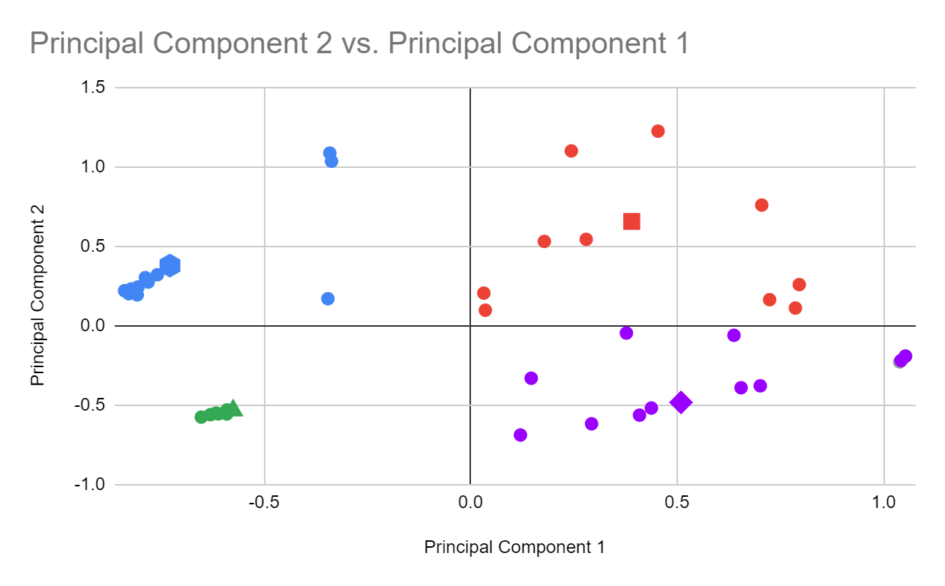
How K-Medoids Work
"This Sample take from 50 first data in dataset"
Step 1 : Choose Number of K
K = 4
Step 2 : Initialize K Medoids randomly
Step 3 : Assign each point to the closest medoids
Step 4 : Recalculate medoids
Step 5 : Iterative (Step 3 - 4)
K-Medoids Explanation

Slide 48
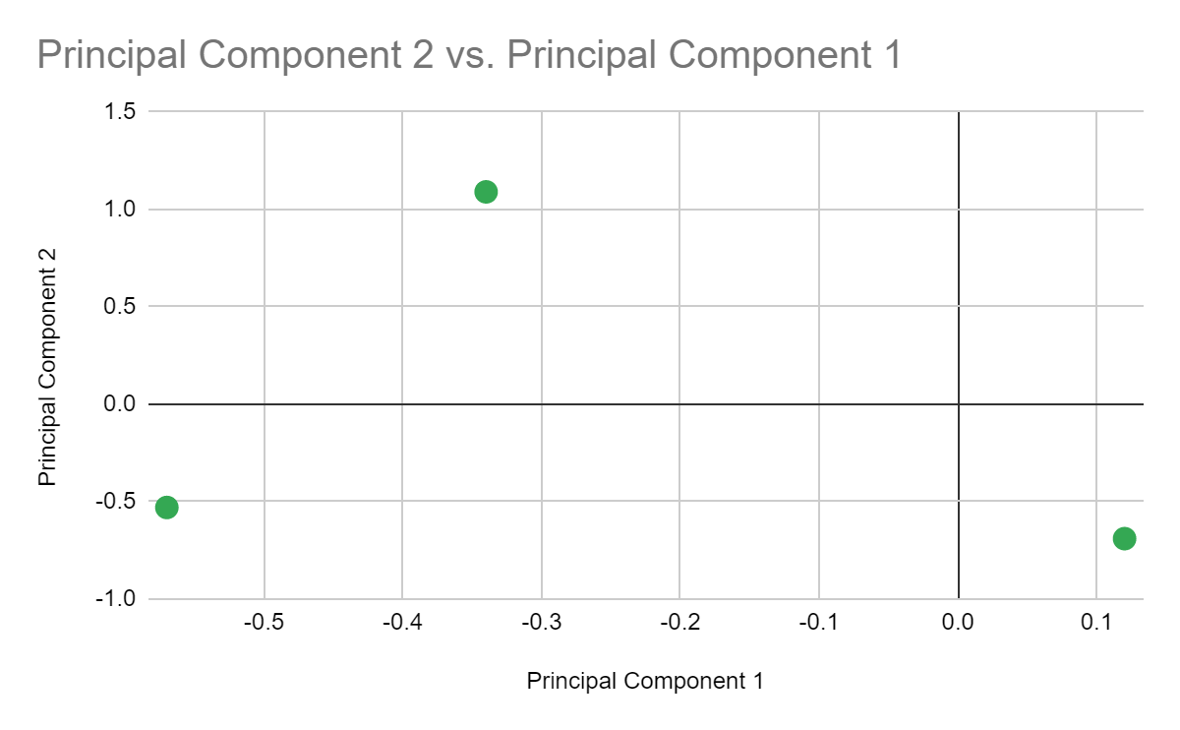
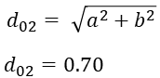
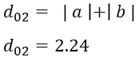
Distance of K-Medoids
"This Sample take from 3 first data in dataset after PCA"
Manhattan
the distance between two
points is the sum of
the absolute differences
of their Cartesian coordinates. Simply it is the sum of the difference between the x-coordinates and y-coordinates
Data 2
(-0.34, 1.09)
2.24
1.85
a
Data 0
(0.12, -0.69)
Data 1
(-0.57, -0.53)
0.85
b
K-Medoids Explanation

Slide 49
Distance of K-Medoids
"This Sample take from 3 first data in dataset after PCA"
Euclidean
metric is the familiar and straightforward line between two elements or the minimum distance between two objects
Data 2
(-0.34, 1.09)
1.83
1.63
a
Data 0
(0.12, -0.69)
Data 1
(-0.57, -0.53)
0.70
b
K-Medoids Explanation

Slide 50
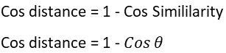
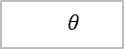
Distance of K-Medoids
"This Sample take from 3 first data in dataset after PCA"
Cosine
measure of similarity between two sequences of numbers.
Data 2
(-0.34, 1.09)
Data 0
(0.12, -0.69)
Data 1
(-0.57, -0.53)
K-Medoids Explanation

Slide 51
K-Medoids Result

Slide 52
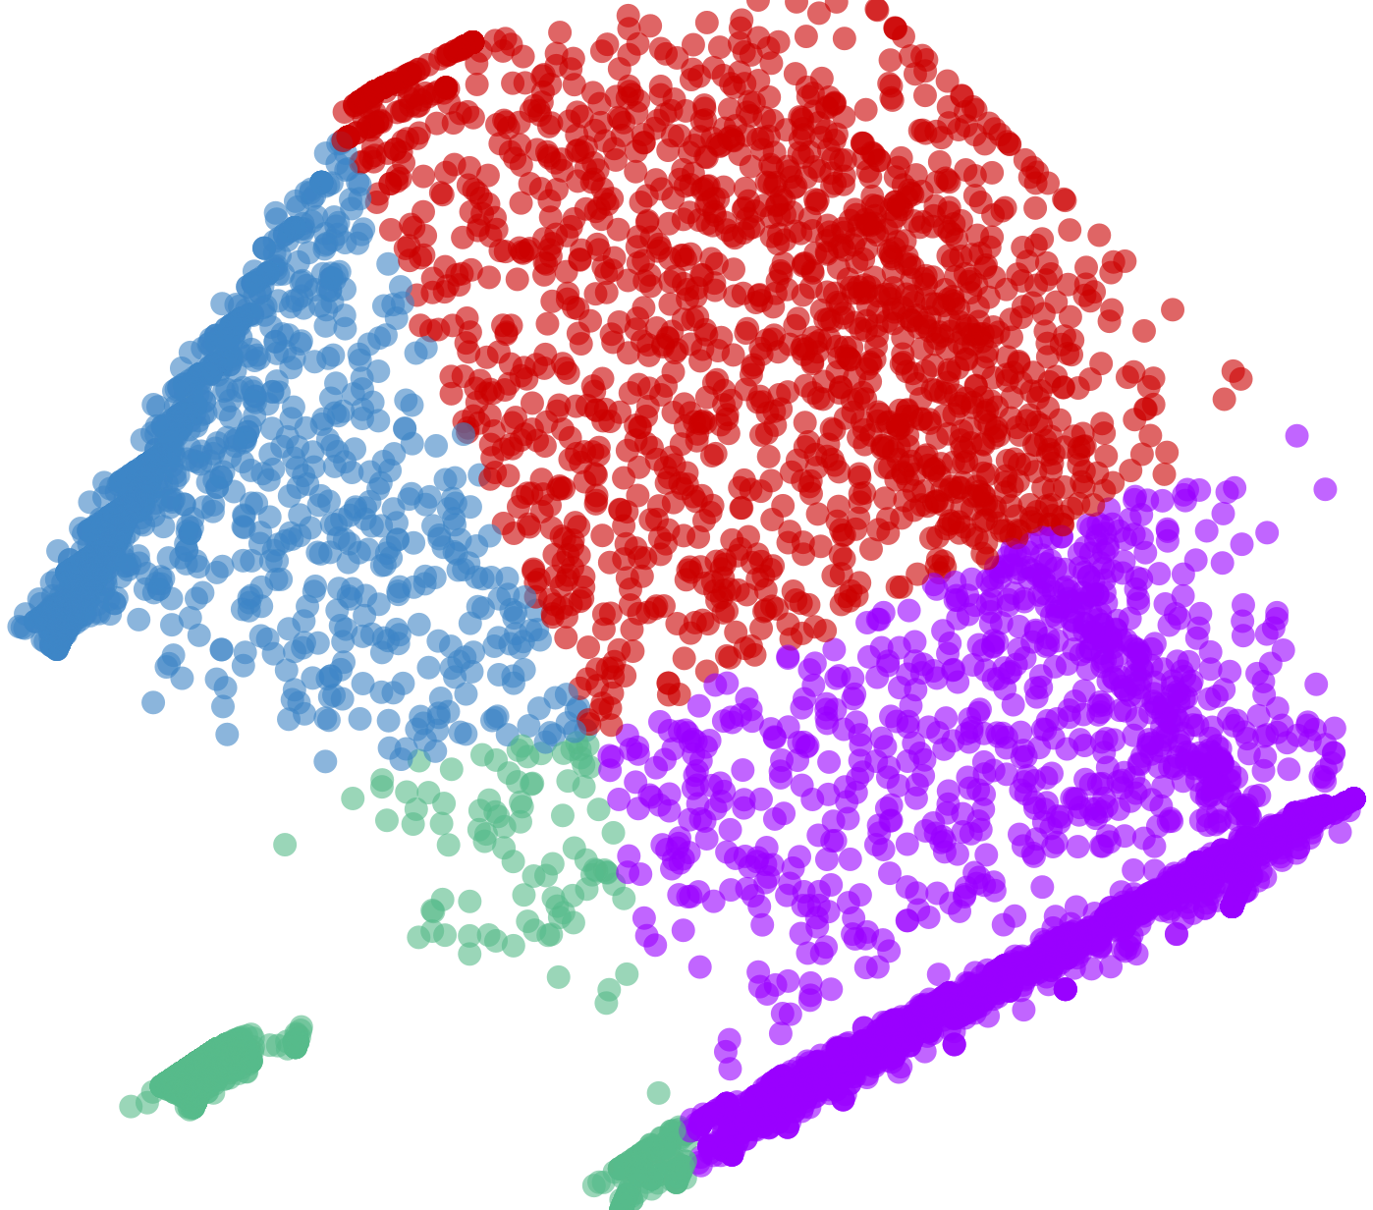
Cluster Result With PCA
MEDOID CLUSTER 0
MEDOID CLUSTER 2
MEDOID CLUSTER 3
MEDOID CLUSTER 1
K-Medoids Result

Slide 53
Cluster
Analysis

Slide 54
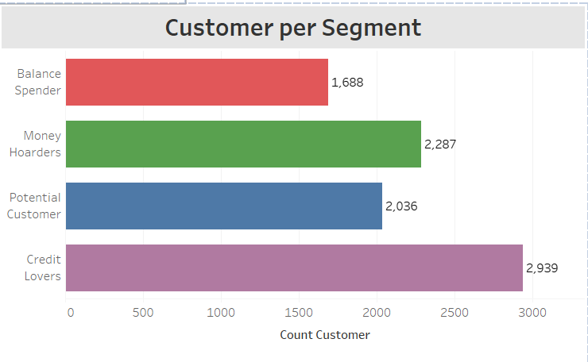
Cluster Analysis
Customer per Segment
The results of our clustering have 4 clusters or 4 customer segments, each cluster has different purchases behavior, we will describe in Conclusion
For complete result please refer to the link below:
Final Project Tableau | Tableau Public
Cluster Analysis

Slide 55
05
Conclusions and Recommendations

Slide 56
Conclusions

Slide 57
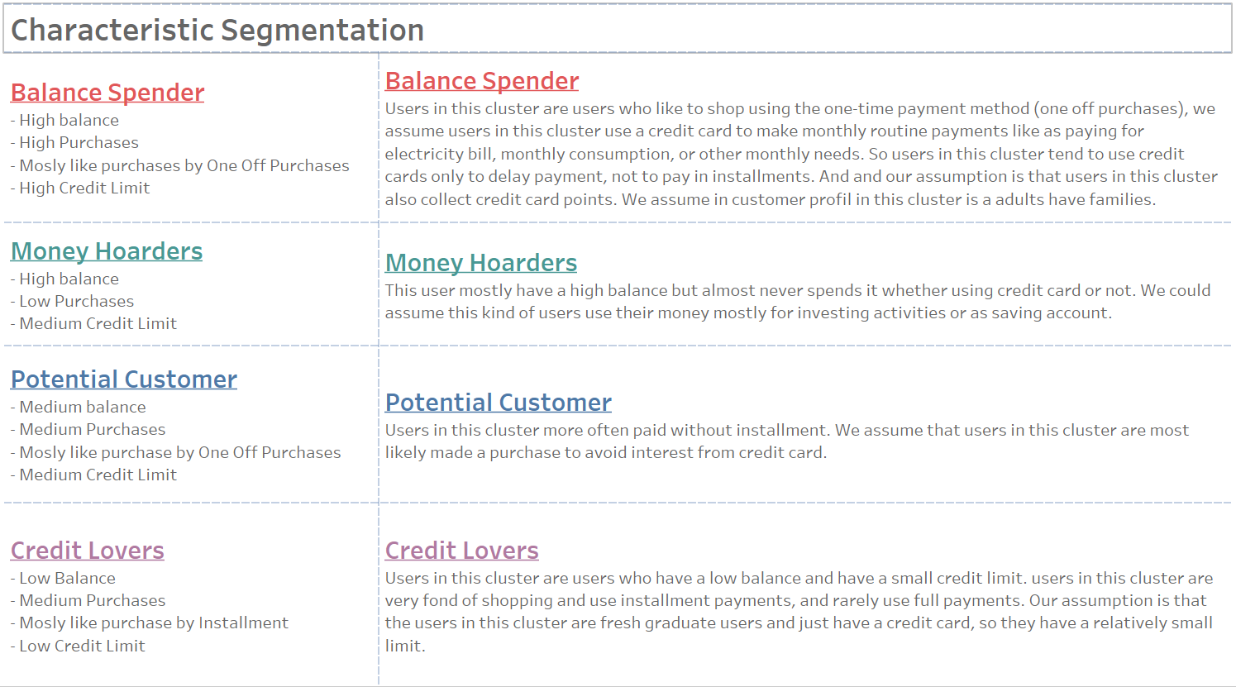
Conclusions
Conclusion

Slide 58
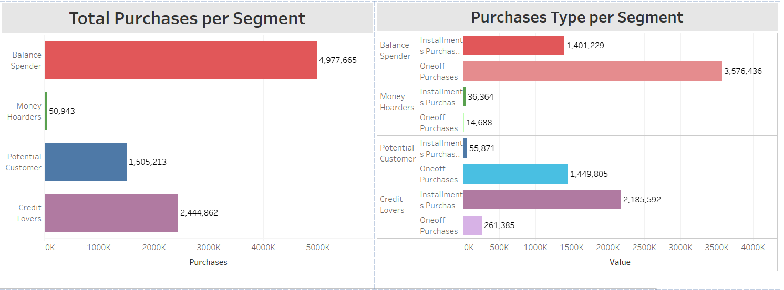
Customer Purchases Behavior
From table we can see the most spender is cluster Balance Spender and cluster often use installment purchases is cluster Credit Lover
Conclusion

Slide 59
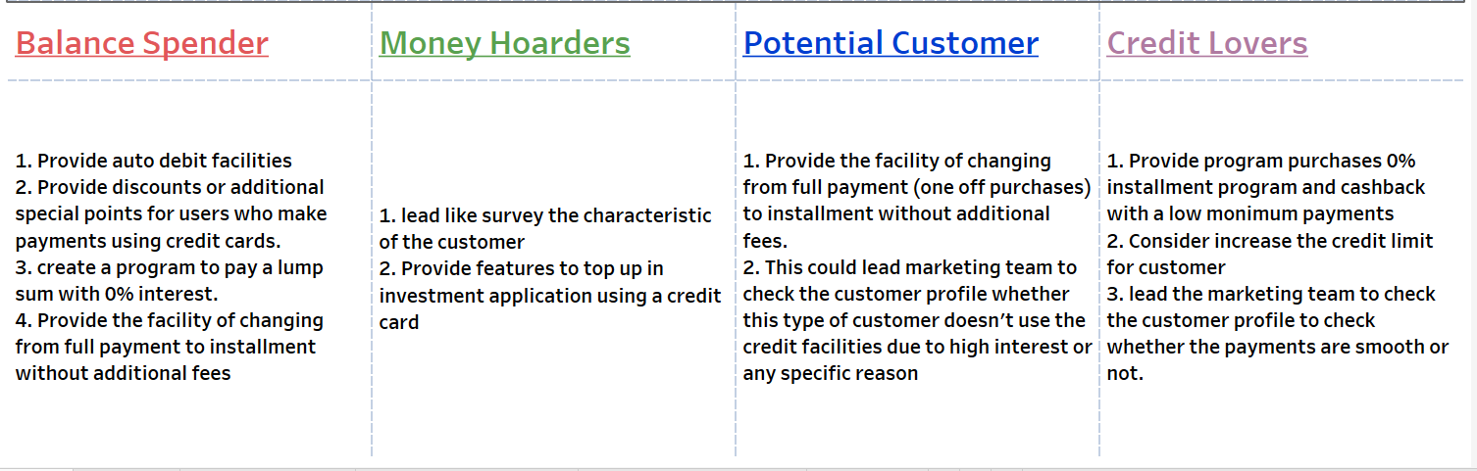
Marketing Strategy
Conclusion

Slide 60
Recommendations

Slide 61
Recommendations
For the Data:
Add more data to the dataset for better modeling
We could use realtime dataset for better result
Add more feature related like Credit Card Type(Silver, Gold, Plat), the date they made the transaction (for trend analysis), customer profile (students, worker, etc), age, income user, work experience
For Modeling:
The cluster result also could be used as a feature or target
The feature we added like (oneoff_proportion, installment purchase, etc) could be used for SPL(Supervised Learning) Regression to predict a credit limit for new user and SPL Classification for categorize new user to which cluster they are
Recommendations

Slide 62
Thank You
If you have any questions or job offers for us, please refer to our linkedin on the team introduction page

